Slide 1
Creating Infographics
with Canva
Taught By: Kasya O’Connor Grant and Emily Sullivan
ENGW3302: Advanced Writing in the Technical Professions
Dr. Philip Gilreath
Spring 2024
Feel free to ask questions at any point during the presentation!

Slide 2
Workshop Agenda
Learn about dynamic and static modes of conveying information.
Review best practices of visualizing data.
Explore how to make visualizations using Canva, a free online tool.
Consider accessibility in designing presentations and infographics.
For more information, please see: https://bit.ly/sp24-gilreath-infographics
SDG Report 2020
Feel free to ask questions at any point during the presentation!

Slide 3
Infographics

Slide 4

Infographics Basics
Infographics present complex information quickly and clearly.
They tell a story with information, mostly images combined with numbers, charts, graphs, and summary text.
They can be as simple as a road sign or as complex as a visual analysis of global economies.
They easily convey information and data to different audiences.
Northeastern University College of Professional Studies
Feel free to ask questions at any point during the presentation!

Slide 5
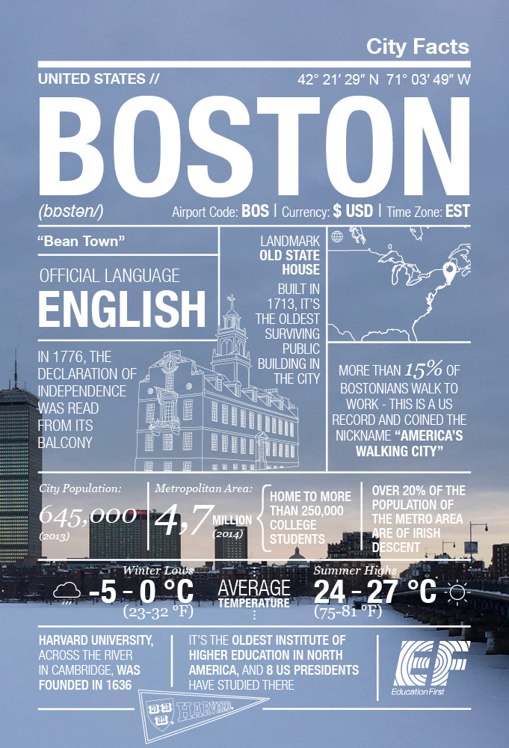
Infographics Help You:
Catch the attention of new users/audiences.
Present more information without overloading audiences; they summarize and synthesize “need to know” information.
Offer concise and simple visuals to help audiences navigate and engage with complex information.
Reach across platforms and media. Infographics are well-suited for both print and digital presentation.
Education First
Feel free to ask questions at any point during the presentation!

Slide 6
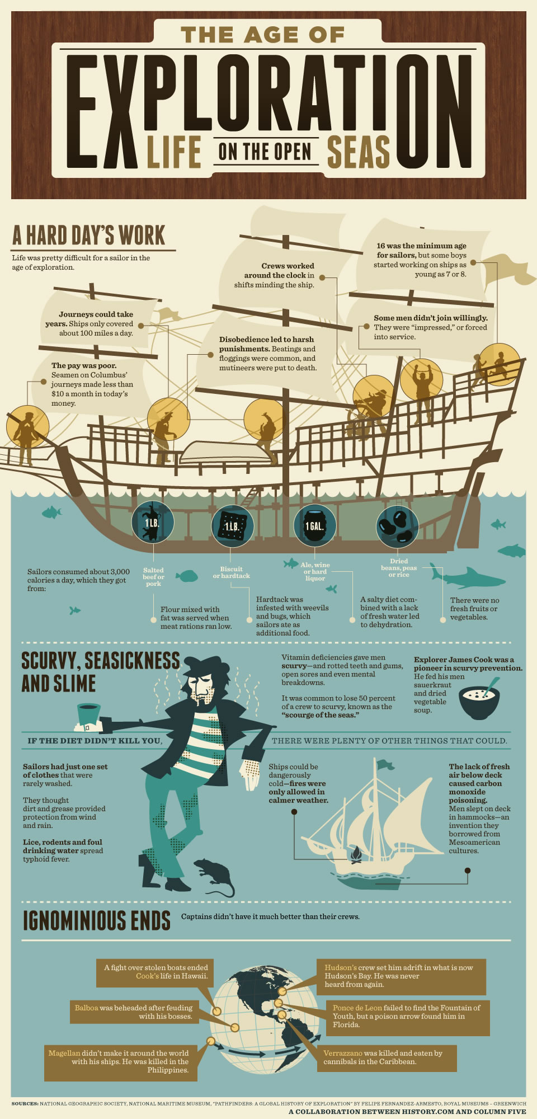
Elements of Infographics
Infographics should have:
A narrow focus or subject matter.
Short and accessible titles.
Visually interesting components.
A structure and sequence to the information they present.
Citations for all of the information included.
History.com & Column Five
Feel free to ask questions at any point during the presentation!
Notes:
Discussion questions:
What kinds of infographics have you seen before? Were they effective? If so, what made them effective? If not, what didn’t work?
What kind of information do you think best suits the structure of an infographic? E.g., should it all be facts and figures? Should there be any wording? If so, how much? What kind of information do you think wouldn’t work on an infographic?

Slide 7
Ingredients of a Good Infographic
Clarity: The visual design and data/text should be clear. Avoid clutter; if it’s hard to read or find your place, there might be too much going on!
Usefulness: Each part of the infographic should contribute to the broader argument or story. Get rid of filler or repetition!
Aesthetics: Good infographics are visually interesting, and balance graphics and text.
Accessibility: Make sure text is not cut off or covered by image, add descriptive alt-text to your infographic image.
For more information on accessibility, please see: https://bit.ly/diti-accessibility
Feel free to ask questions at any point during the presentation!

Slide 8
Questions to Consider: Text to Visuals
How can visuals enhance your writing?
What elements of your writing do you think could be improved by being presented in an infographic format (ie. thesis, structure, flow, etc)?
What are some obstacles you might face when converting your writing to an infographic format?
Feel free to ask questions at any point during the presentation!
Notes:
How do you decide what should be text and what should be image? Part of the process is deciding what is most important, and making those parts bigger and brighter.

Slide 9
Build a coherent argument or story
Treat your presentation like any other form of argument, explanation, or narrative—be intentional, and organize your points chronologically or as ordered steps in a process.
Put main ideas front-and-center, and consider having your points progress down orders of importance.
Use signposts or sections to orient your audience, i.e. pairing each point with numbers, shifting color gradients, etc.
Feel free to ask questions at any point during the presentation!

Slide 10
Some more tips
Draw up an outline or storyboard before you build the graphic.
Have a specific and clear title.
Contain carefully-proofed syntax and vocabulary, and explain terms/jargon.
Have proper citations.
Don’t mix visual types on a single slide. Keep a consistent font, color scheme, animation effects, design, formatting, etc.
Limit text—keep negative space for the graphical component.
Feel free to ask questions at any point during the presentation!

Slide 11
Keep it Visible: Fonts
Times New Roman: Keep it visible
EB Garamond: Keep it visible
Arial: Keep it visible
Droid Sans: Keep it visible
Caveat: Keep it visible
Comic Sans: Keep it visible
Cambria: Keep it visible
Sans serif fonts are typically the best for presentations.
Use no more than two complementary fonts (e.g., Arial and Arial Bold for emphasis).
Use mixed case, not all CAPS.
Bold vs. Underline vs. Italics.
Feel free to ask questions at any point during the presentation!

Slide 12
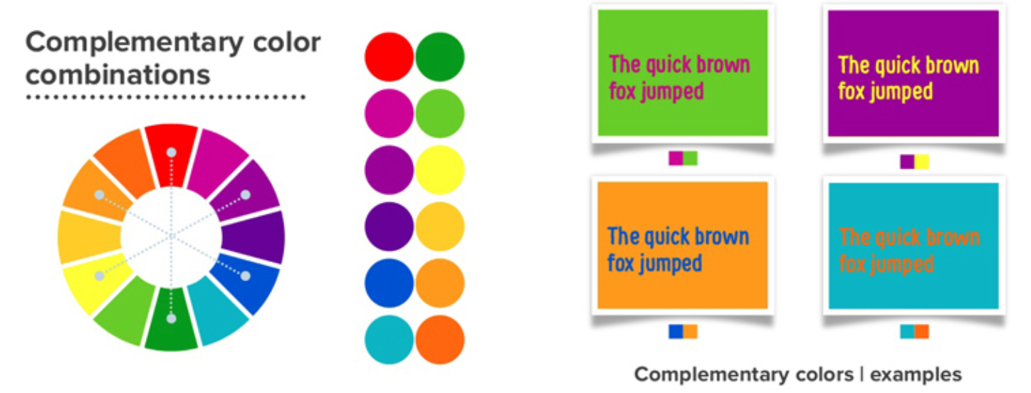
Keep it Visible: Colors
Make color choices that are accessible to everyone (and appropriate for the presentation).
Ideal color schemes are high contrast (use a contrast checker).
Think about limiting your palette (3 colors can be effective).
Find complementary colors (e.g. this tool).
NU Colors provides the Northeastern University palette.
Visme Blog
Feel free to ask questions at any point during the presentation!

Slide 13
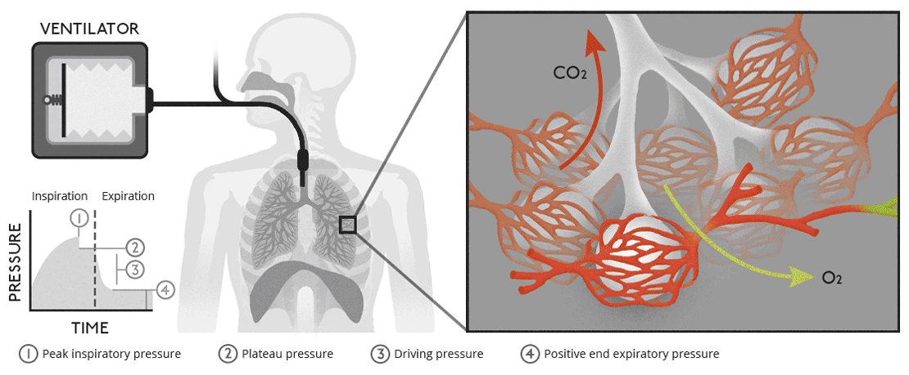
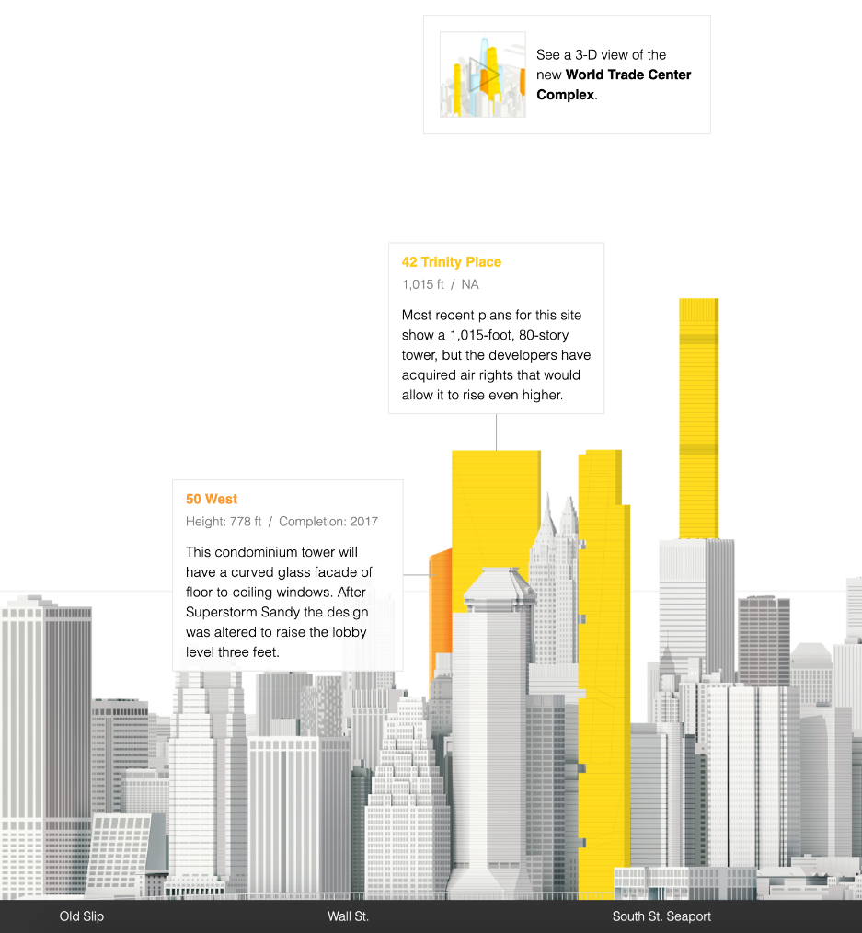
Infographic Formats
Static infographics:
Typically fixed information a still image.
Motion infographics:
Typically fixed information. Display output is animated, or moving.
Interactive infographics:
Can be fixed or dynamic information input.
User interaction consists of searching for specific data, actively shaping the content displayed, and choosing which information is accessed and visualized.
“Biology of ventilation,” tapletopwhale.com
From “The New New York Skyline,” National Geographic
Feel free to ask questions at any point during the presentation!

Slide 14
Getting Started with Canva

Slide 15
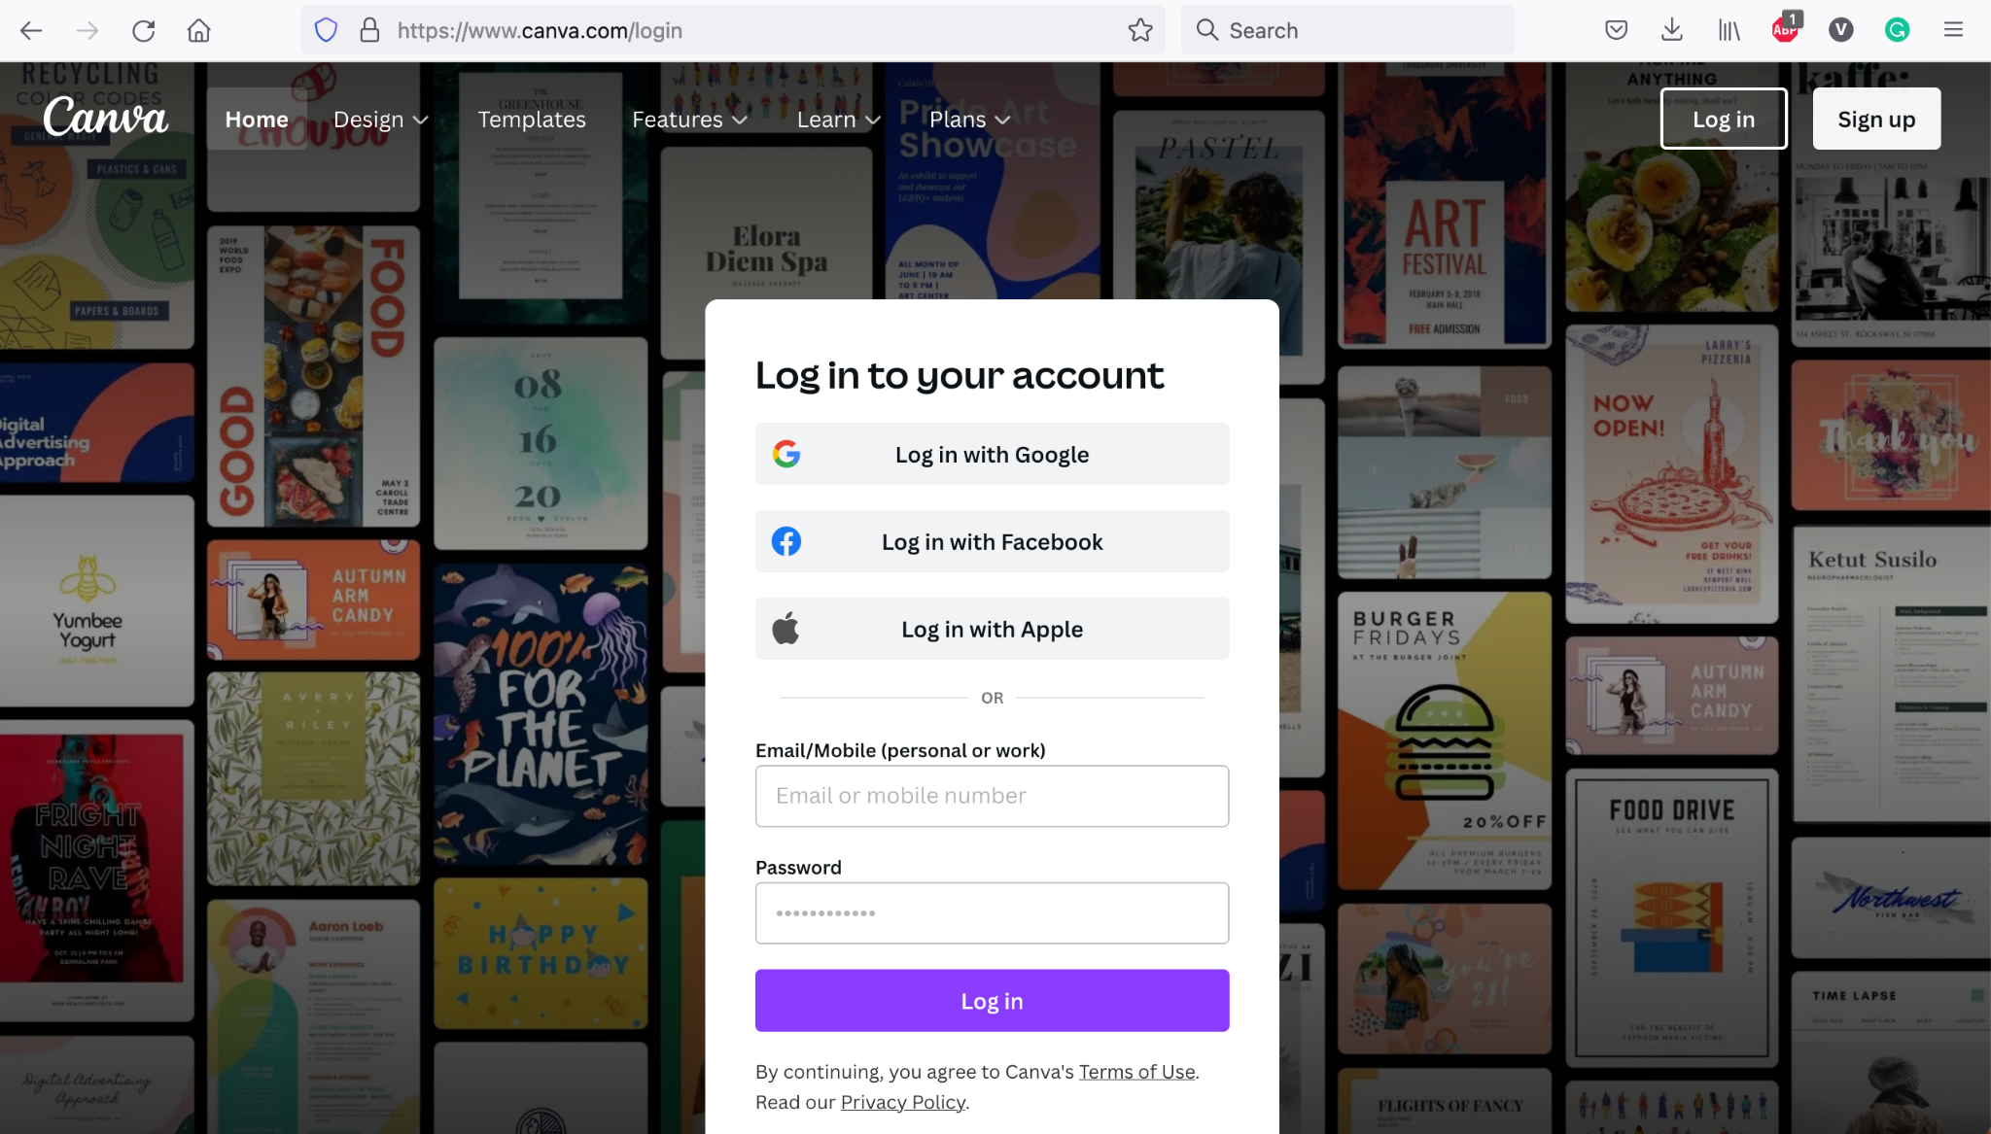
Sign up/Login
Canva is a free online infographic maker.
Use your Gmail/Facebook/Apple ID to sign up or create an account.
Click “Create A Design.”
Feel free to ask questions at any point during the presentation!

Slide 16
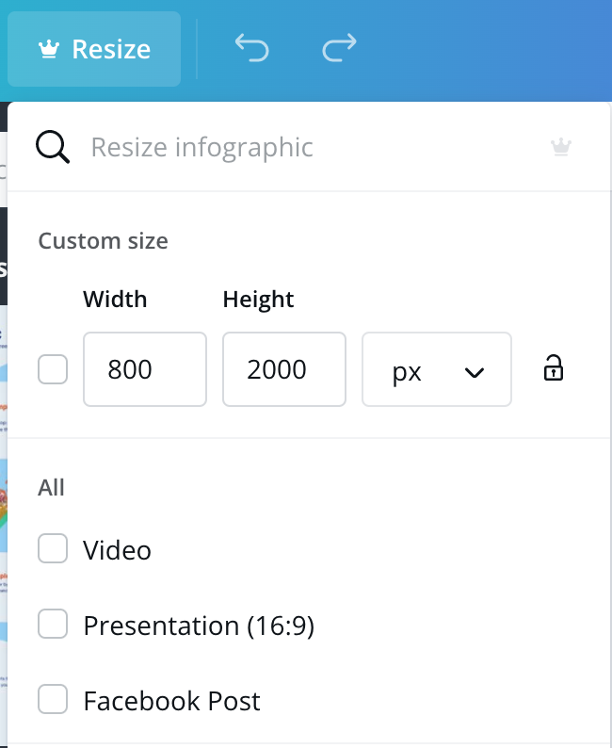
Starting Up...
First, pick your canvas dimensions. Canva features a curated ‘infographic’ size, but you can customize the width and length when opening a new graphic. You can also add more ‘pages.’
Unfortunately, resizing and adding pages in an already existing graphic is only available in paid subscriptions.
Infographics work best when presenting information through one direction, so it might help to size your canvas as being long either vertically or horizontally.
Feel free to ask questions at any point during the presentation!
Notes:
Which direction makes the most sense for your information delivery- vertical or horizontal?

Slide 17
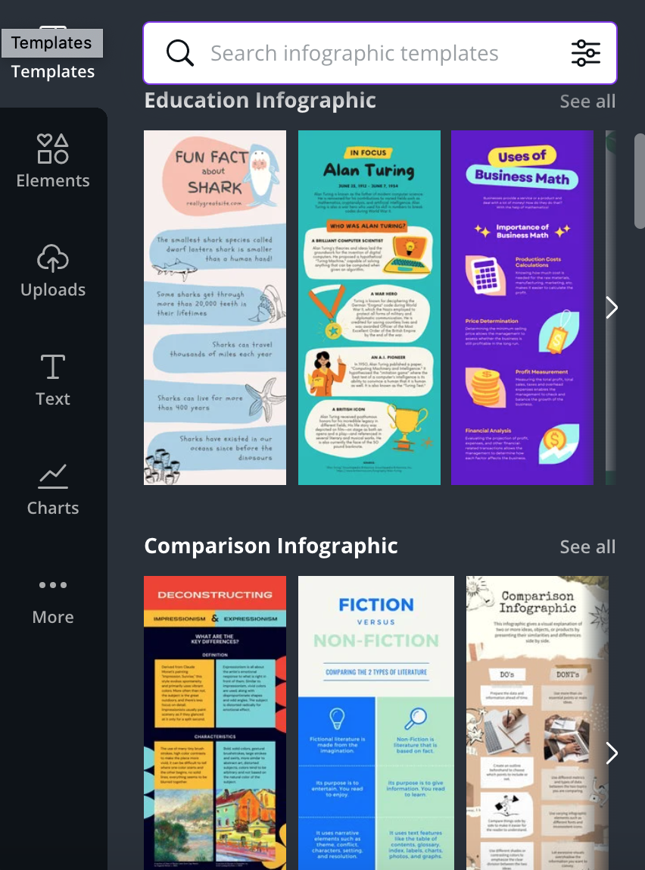
Pick a Style
Infographics work best when presented in a uniform style.
Try to get your information and your design to work together!
If you need some help or inspiration, Canva offers several infographic templates you can start from.
Feel free to ask questions at any point during the presentation!

Slide 18
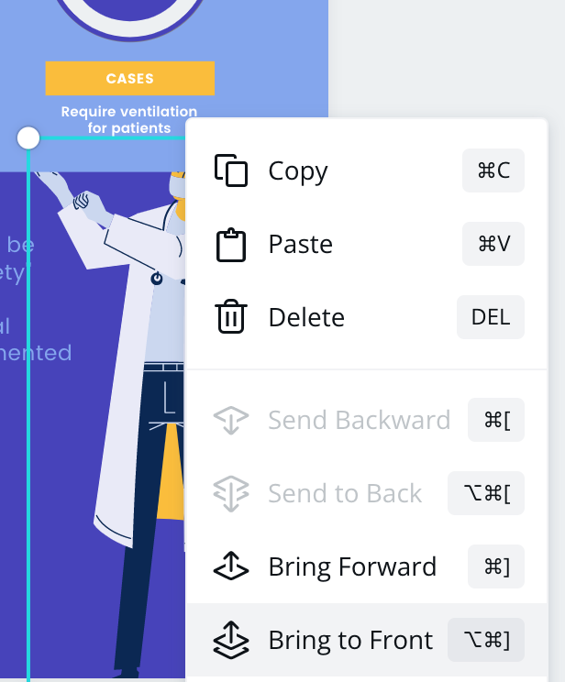
Layers
Canva works by combining several graphic layers.
Layers can be anything that shows up on the canvas—elements, charts, text, etc.—and can be customized in many ways. You can drag them around, change their colors, resize them, and more!
Remember that you can always send a layer ‘forward’ or ‘back’ relative to other layers with a right click on PC, control click on Macs (or use the key commands shown at right) →
Feel free to ask questions at any point during the presentation!
Notes:
It is important to make sure that information isn’t cut off or hard to see if you have multiple layers of content.

Slide 19
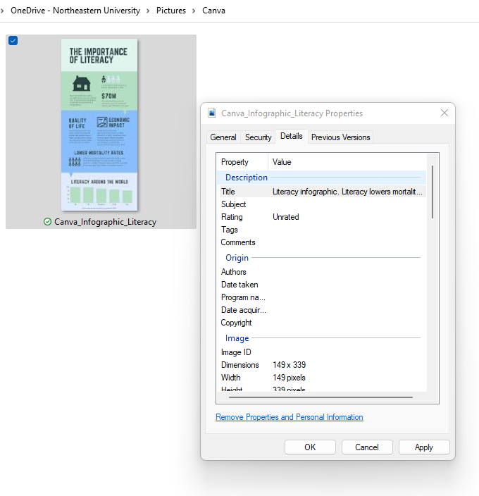
Alt-Text
Alt-text is a description of an image that conveys the image content and meaning. This descriptive text is attached to the image’s file properties.
People with low or no vision can use assistive technology like screen readers to hear the alt-text description of digital images. When a screen reader reaches the image, it will read the alt-text description out loud.
Based on : Microsoft’s How to write effective alt-text
Feel free to ask questions at any point during the presentation!

Slide 20
Adding Alt-Text
You can export your infographic as an image and then add alt-text.
Find the image in your file directory.
On PC: Right-click the image and select ‘Properties.’ Choose the ‘Details’ tab and click on the ‘Title’ field.
On Mac: Control-click the image and select ‘Get Info’ on Macs, then edit the ‘Comments’ field.
Write a description of and insights from your infographic.
Feel free to ask questions at any point during the presentation!

Slide 21
Example: Alt-Text
What are 2-3 takeaways from this infographic?
What information do you think is important to include in alt-text for this infographic?
Northeastern University College of Professional Studies
Notes:
In addition to including main takeaways in the alt-text, it is important to include where the data comes from, who made the infographic, what purpose the infographic has, etc. Imagine if you only had 3 sentences to describe the most important information in this image--what you choose to include matters and can increase user access.

Slide 22
Discussion: Accurately Representing Data in Visuals and Infographics
―Developed in collaboration with BARI

Slide 23
Data Presentation Tips
Create your own tables, or make sure to use only images that are shared with permissions that support reuse—and always cite your sources!
Be sure to present your data accurately—be mindful that your charts, graphs, maps, and infographics are scaled and structured to present data and conclusions completely and correctly.
Use visual representations of numbers—this will help concretize abstract concepts.
Label judiciously, but don’t overwhelm the viewer with dense text.
Beware of trying to make too many points in one graphic—focus on the big takeaways.
Feel free to ask questions at any point during the presentation!

Slide 24
Limitations of Some Data Presentation Methods: Charts, Graphs, Diagrams, Maps
The structure and scale of charts and graphs could be manipulated to amplify or diminish differences.
Different types of graphs and charts work better for some types of data than others—for example, a pie chart and a line graph might not both be able to represent the same data accurately.
A chart with too much information will be difficult to understand, but too little information could be an indication that data has been cherry-picked to support an argument.
There is limited space in an infographic for in-depth analysis; nuances can be flattened and obfuscated.
Feel free to ask questions at any point during the presentation!

Slide 25
Misrepresentation of Data
From D.B. Resnik, in the International Encyclopedia of the Social & Behavioral Sciences, 2001:
“The concept of ‘misrepresentation,’ unlike ‘fabrication’ and ‘falsification,’ is neither clear nor uncontroversial. Most scientists will agree that fabrication is making up data and falsification is changing data. But what does it mean to misrepresent data? As a minimal answer to this question, one can define ‘misrepresentation of data’ as ‘communicating honestly reported data in a deceptive manner.’”
This online book from The Data School covers some common ways data could be misrepresented at multiple points in the process of gathering, analyzing, and presenting findings on data-based research.
Feel free to ask questions at any point during the presentation!
Notes:
Situate in a relevant context, relatable situations: COVID misrepresentations of public data and real-world impact of false data
Be mindful of data representation especially online because of potentially contributing to false realities, COVID misinformation, climate misinformation, etc.
Ask students: have you seen data misrepresented in the news, social media, or in other public-facing content? What effect do you think this has on public?

Slide 26
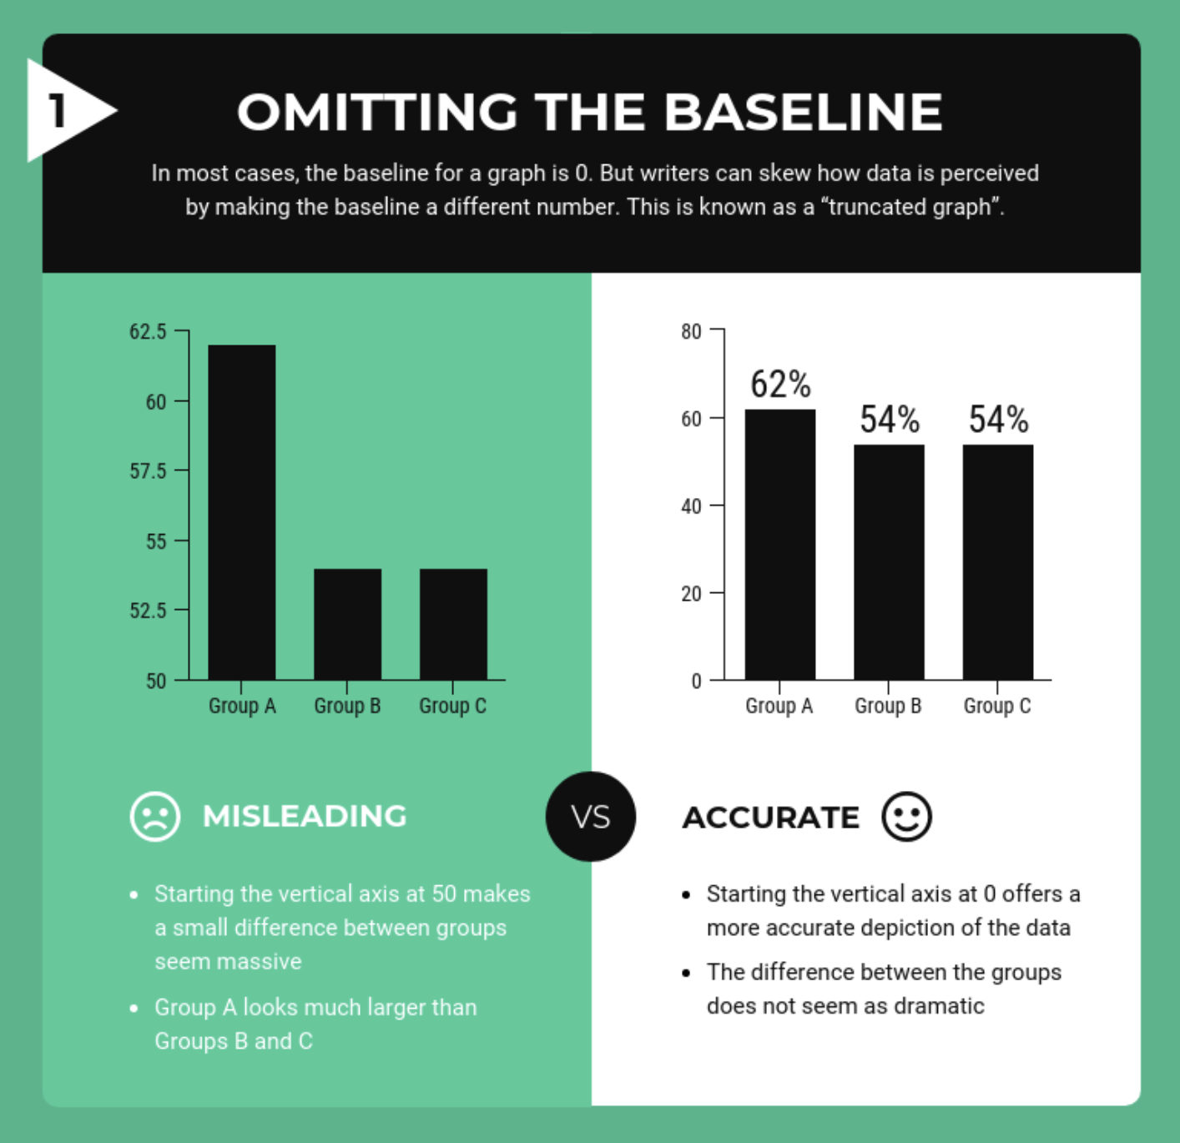
Limitations of Charts, Diagrams, Graphs, & Maps
Consider these questions as you review the examples in this section:
What commonalities do you notice among the more misleading and more accurate versions of graphs and charts in these examples?
How would you define “accuracy” in the context of data presentation? Why is that question essential to ask?
In what contexts does it make the most sense to use these kinds of visuals to present data? Are there other times where they’re inappropriate? How so?
Feel free to ask questions at any point during the presentation!

Slide 27
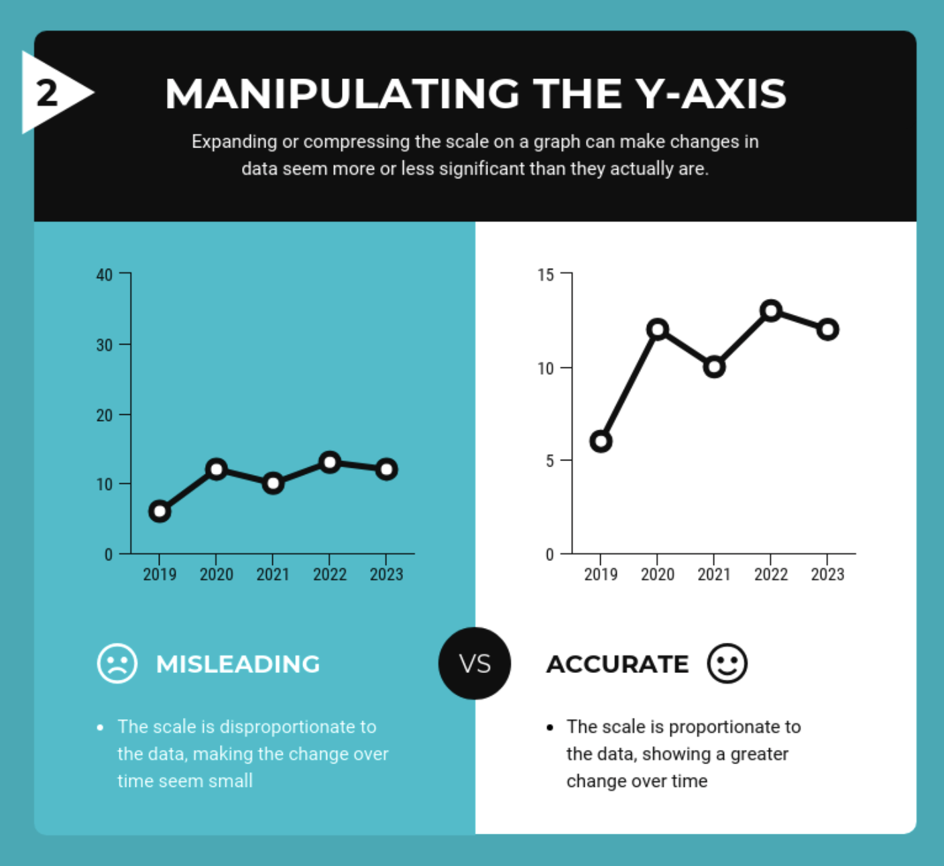
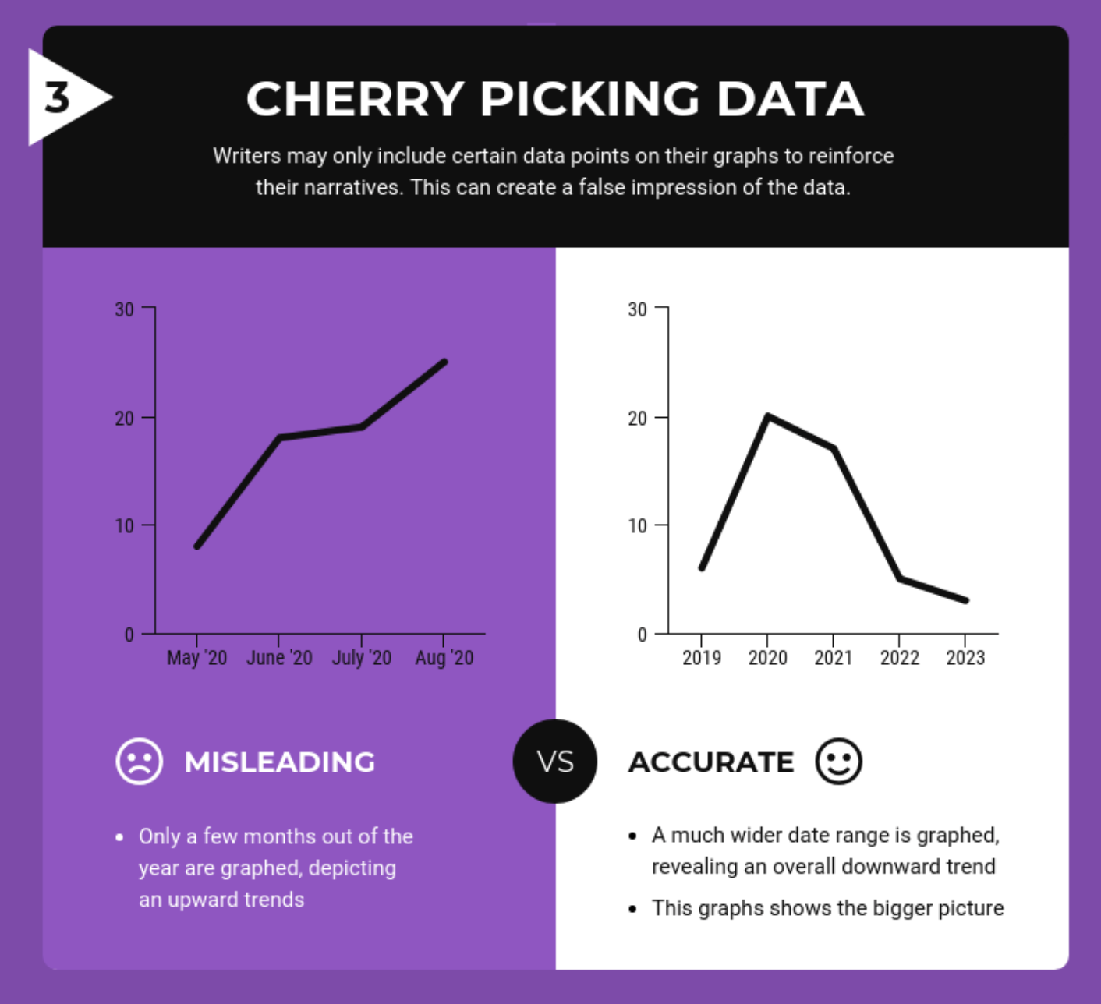
More limitations with presenting data using CHARTS and DIAGRAMS:
Feel free to ask questions at any point during the presentation!

Slide 28
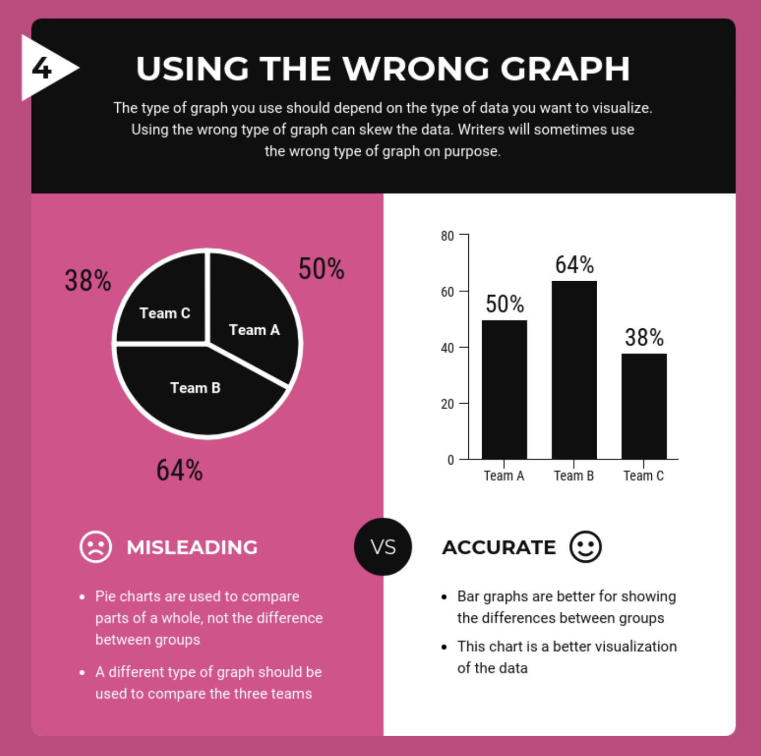
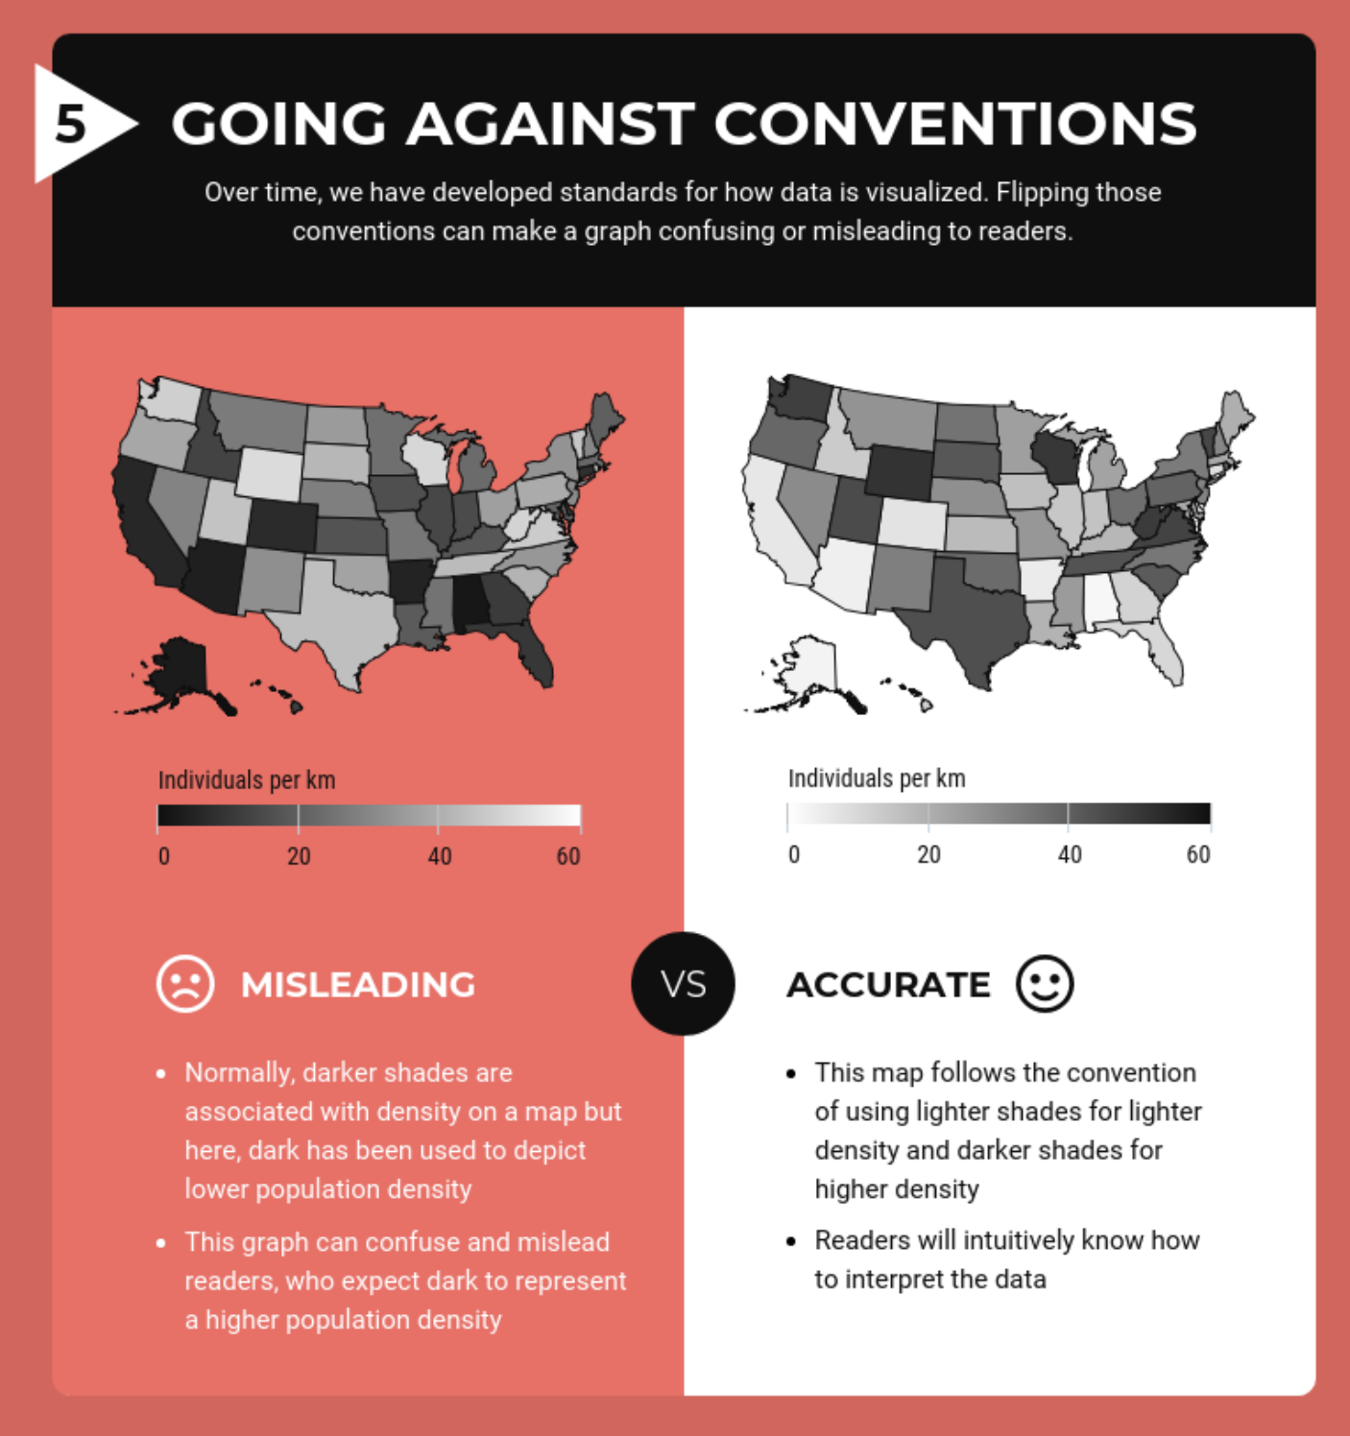
Limitations with presenting data using GRAPHS and MAPS:
Feel free to ask questions at any point during the presentation!

Slide 29
Discussion: Text to Visuals
How can visuals enhance your writing?
What elements of your writing do you think could be improved by being presented in an infographic format (ie. thesis, structure, flow, etc)?
What are some obstacles you might face when converting your writing to an infographic format?
Feel free to ask questions at any point during the presentation!
Notes:
How do you decide what should be text and what should be image? Part of the process is deciding what is most important, and making those parts bigger and brighter.

Slide 30
For Further Exploration
Here are links to the handouts presented in these slides:
https://bit.ly/infographics-handout
https://bit.ly/diti-accessibility
See also the Beginner’s Guide, published by Canva
Feel free to ask questions at any point during the presentation!

Slide 31
Your Turn!
Practice creating an infographic in Canva.
Notes:
Using the sources of information you’ve already picked out for your projects, begin creating an infographic layout in Canva.

Slide 32
Thank you!
Developed by DITI Research and Teaching Fellows Kasya O’Connor Grant, Dipa Desai, Emily Sullivan, and Javier Rosario
For more information on DITI, please see: https://bit.ly/diti-about
Schedule an appointment with us! https://bit.ly/diti-meeting
If you have any questions, contact us at: nulab.info@gmail.com
Link to Online Materials: https://bit.ly/sp24-gilreath-infographics
Feel free to ask questions at any point during the presentation!

